Slide 1
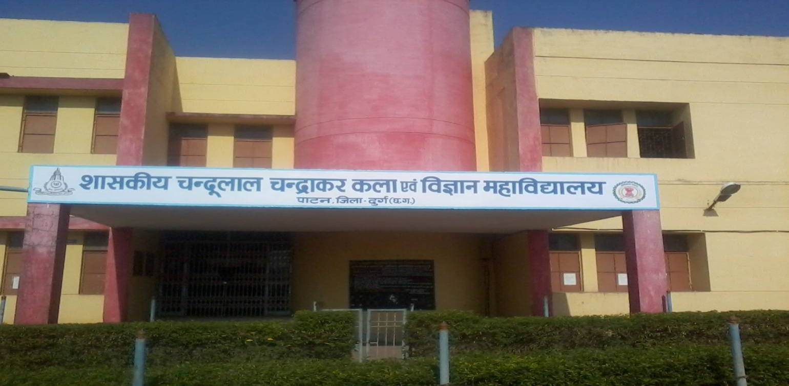
Govt. Chandulal Chandrakar Arts & Science College, Patan, Dist-Durg
AFFILIATED TO HEMCHAND YADAV Vishwavidyalaya,DURG (C.G)
AISHE-C-21675; UGC-202013; NAAC-CHCOGN15565
Department of PHYSICS
Welcomes
NAAC PEER TEAM
15th -16th September 2021

Slide 2
Contents…….
DEPARTMENTAL PROFILE
PROGRAMS OFFERED
VISION, MISSION AND OBJECTIVES
ACTION PLAN
PROGRAMME SPECIFIC OUTCOMES
ACADEMIC ACHIEVEMENTS
RESEARCH PUBLICATIONS
AWARDS
M.SC. STUDENTS ACHIEVEMENTS
RESULT ANALYSIS
UGC XII PLAN
PGDCA
RESULT ANALYSIS

Slide 3
Departmental Profile
The department of Physics is established in session 2020-21 with the opening of Post-graduation in physics. However Undergraduate course in Physics is started since 1990.
Sanctioned Teaching Post
Post | Sanctioned | Filled
Professor | Nil | Nil
Associate Prof. | Nil | Nil
Asst. Prof. | 02 | 01
Non-Teaching Post
Post | Sanctioned | Filled
Lab-Technician | 01 | 01
Lab-Attendand | 01 | Nil

Slide 4
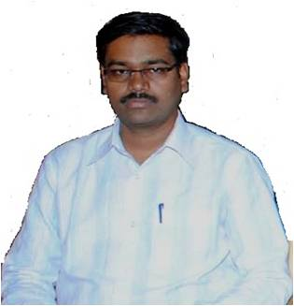
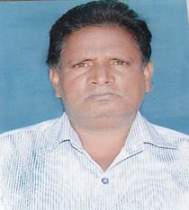
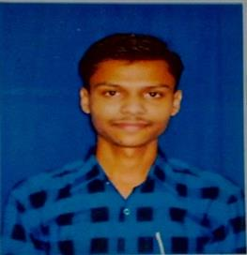
Sr.No. | Name | Designation | Qualification | Incharge
01 | Mr. UGENDRA KUMAR KURREY | Asst. Prof. | M.Phil,Ph.D. (Pursuing) | 1.HoD Physics Department. 2. HoD PGDCA 3. NAAC Coordinator.(from June 21 to Till date) 4. UGC In charge. (from August 2018 to Till date) 5. Member in RUSA Committee.
02 | Mr. THAKUR RAM | Lab- Technician | HSS Board | 1. Student Clerk
03 | Mr. MANOJ KUMAR | Asst. Prof. (Guest ) | M.Sc.
Mr. UGENDRA KUMAR KURREY
Mr. THAKUR RAM
Mr. MANOJ KUMAR

Slide 5
PROGRAMS OFFERED
B.Sc. (PHYSICS)
Year of Establishment- 1990
M.Sc. (PHYSICS)
Year of Establishment- 2020

Slide 6
VISION
To build a foundation of excellence and encourage the students by igniting and promoting enthusiasm, interests and passion, in the study of physics.
MISSION
To awaken young minds and make them realize their talents both in theory and in practical Physics through commitment in teaching and mentoring.
To create intellectual property through innovations.
To support the developmental activities in the department.
To generate resources through networking, collaboration and linkages.
OBJECTIVES
To create human resources with strong foundation in Physics.
To motivate students towards research in Physics.
To organize outreach activities to promote scientific culture.

Slide 7
ACTION PLAN FOR NEXT FIVE YEARS
To provide value based high quality education to the students by using ICT technology.
To enhance the learning capacity arranges the lectures of eminent professors and scientist.
To develop well equipped optics and electronics laboratory for experiments.

Slide 8
PROGRAMME SPECIFIC OUTCOMES
Undergraduate course in Physics would provide the opportunity to the students:
To understand the basic laws and explore the fundamental concepts of physics.
To understand the concepts and significance of the various physical phenomena.
To carry out experiments to understand the laws and concepts of Physics.
To motivate the students to pursue PG courses in reputed institutions

Slide 9
The Master degree in Physics provides
Required knowledge, general competence, and analytical skills on an advanced level, needed in industry, consultancy, education, research, or in public administration.
The students would gain substantial knowledge in various branches of physics: Electronics, Quantum, classical, statistical mechanics, condensed matter physics, astrophysics, particle, nuclear and high energy Physics.
Would learn use of mathematical tools in solving complex physical problems and have the solid background and experience required to model, analyze, and solve advanced problems in physics.
This course would empower the student to acquire scientific skills and the required practical knowledge by performing experiments in general physics and electronics. Would also get some research oriented experience by doing theoretical and experimental projects in the last semester under the supervision of faculty.
The course as a whole opens up several career doors for the students interested in various areas of science and technology in private, public and government sectors.
Students may get job opportunities in higher education, research organizations etc.

Slide 10
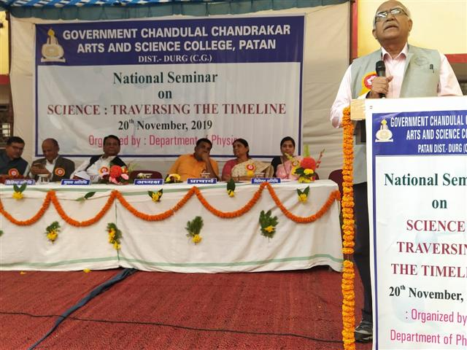
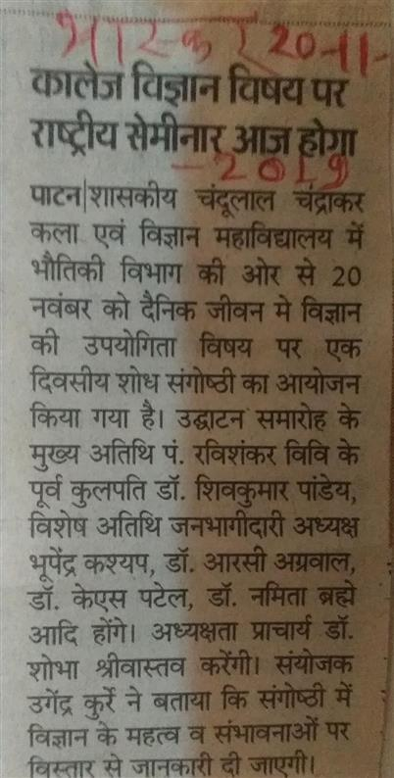
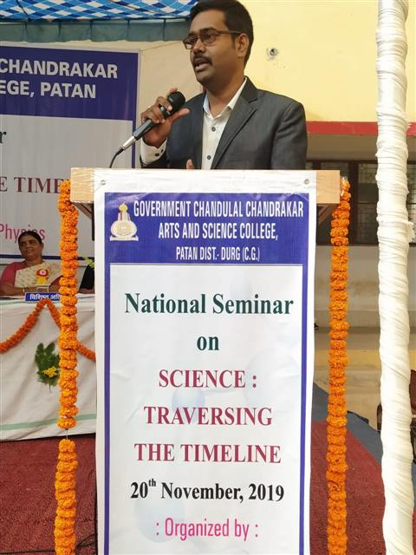
Academic Achievements
The Department of Physics, Government Chandulal Chandrakar Arts and Science College Patan, Dist.- Durg (Chhattisgarh) organized a National Seminar on the topic, "SCIENCE:TRAVERSING THE TIMELINE" on 20 November 2019

Slide 11
1. Research Publications
Sr. No. | Title | Author’s Name | Journal Details
1. | Effect of Excitation Energy on Photoluminescence Properties of Ti Doped ZrO₂ Phosphors | Ugendra Kurrey, Nameeta Brahme, D.P. Bisen and Shweta Sharma | International Journal of Luminescence and Applications (ISSN: 2277-6362) Vol. 7, No. 3-4, October - December 2017. Article ID: 247. pp.446-450.
2. | Optical properties of rare earth (Ce) and transition metal (Ti) doped ZrO₂ phosphors | Ugendra Kurrey, Nameeta Brahme and D.P. Bisen. | IOP Conf. Series: Materials Science and Engineering 1120 (2021) 012002 doi:10.1088/1757-899X/1120/1/012002

Slide 12
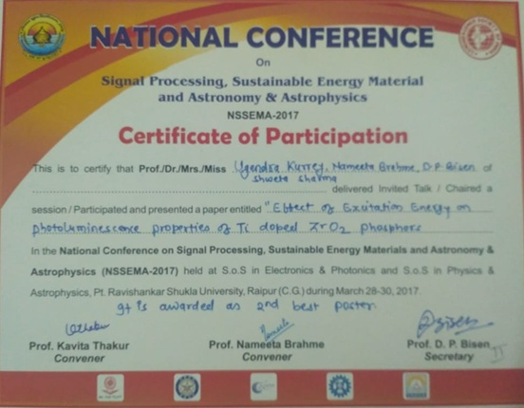
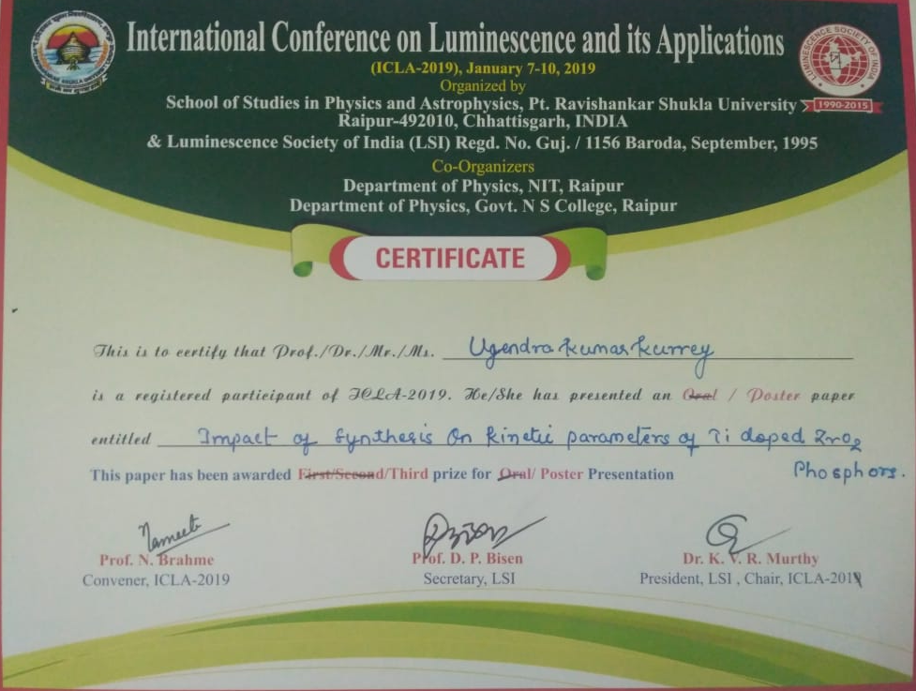
2.Awards
Got Second Best Poster Award in National Conference on “Signal Processing, Sustainable Energy Material and Astronomy & Astrophysics (NSSEMA-2017)”
held at S.o.S. in Electronics & Photonics and S.o.S. in Physics & Astrophysics, Pt. R.S.University, Raipur (C.G) during March 28-30,2017
2. Got Third Best Poster Award in International Conference on “Luminescence and its Applications (ICLA-2019)”
Organized by S.o.S. in Physics & Astrophysics, Pt. R.S.University, Raipur (C.G) & Luminescence Society of India (LSI) during January 7-10, 2019.

Slide 13
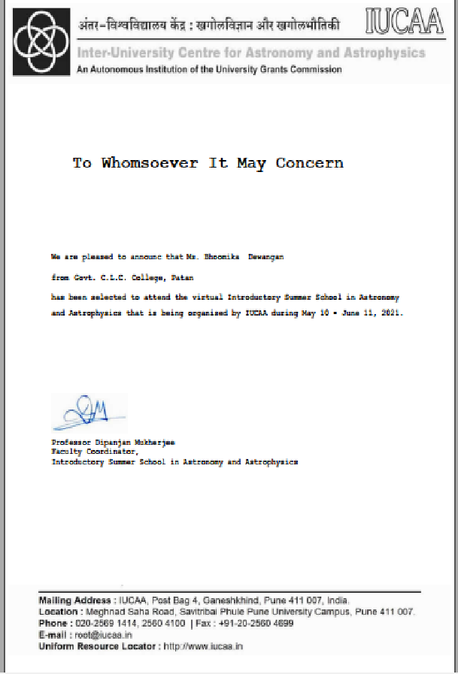
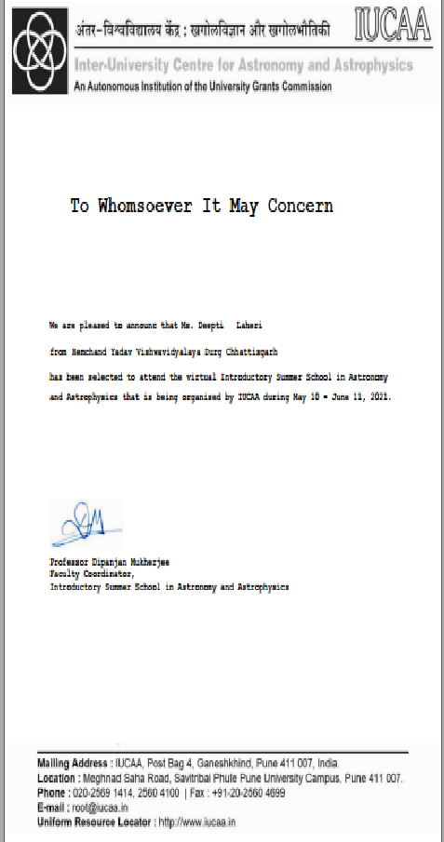
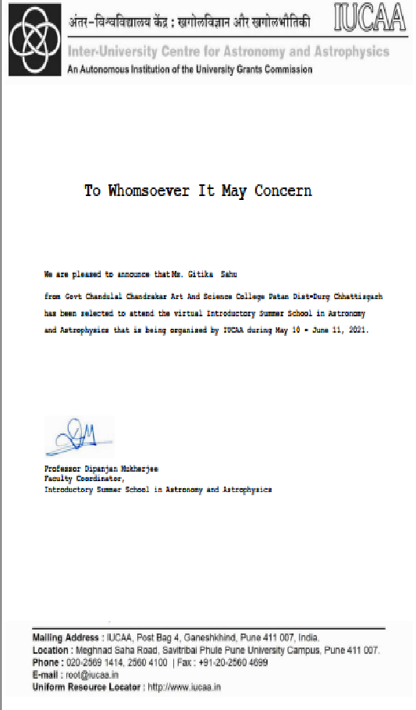
M.Sc. Students Achievements
List of students participated in Summer School Program
Sr. No. | Student name | Summer School
01 | Ms. BHOOMIKA DEWANGAN | IUCAA
02 | Ms. DEEPTI LAHRI | IUCAA
03 | Ms. GITIKA SAHU | IUCAA

Slide 14
Result Analysis
ENROLLED AND EXAM RESULTS OF B.SC.-III (Physics)
YEAR | ENROLLED | APPEARED | PASS | RESULT
2014-15 | 21 | 21 | 21 | 100%
2015-16 | 15 | 15 | 14 | 93.3%
2016-17 | 24 | 24 | 23 | 95.8%
2017-18 | 27 | 27 | 25 | 92.5%
2018-19 | 26 | 26 | 26 | 100%
2019-20 | 35 | 35 | 35 | 100 %

Slide 15
Appeared and Passed students for B.Sc.III year…

Slide 16
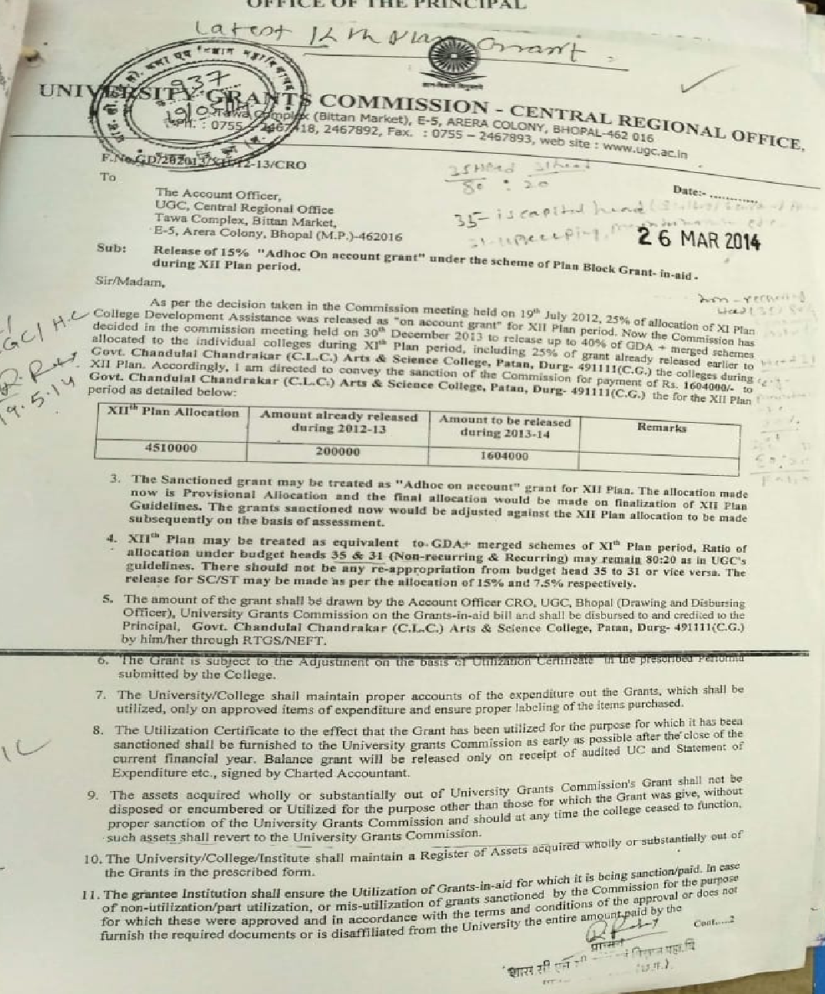
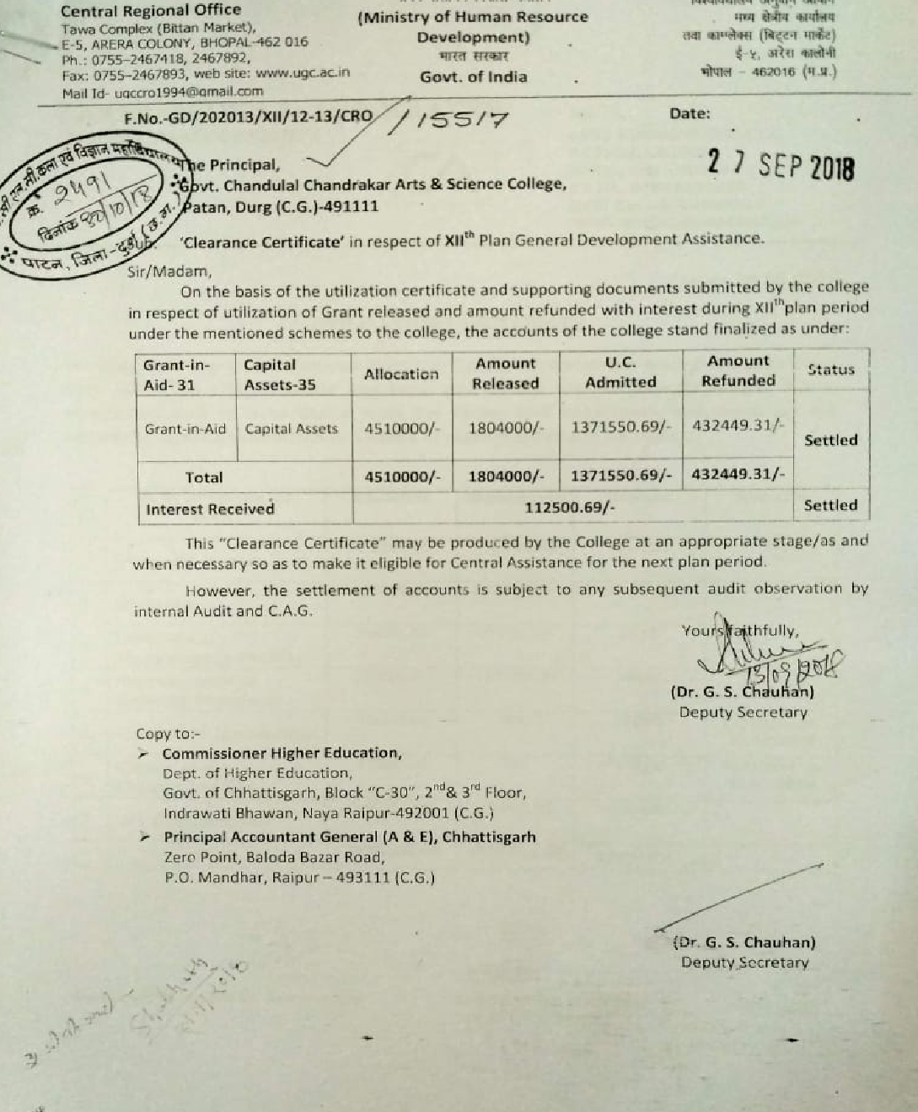
UGC - XII Plan
Allocation letter
Clearance Certificate

Slide 17
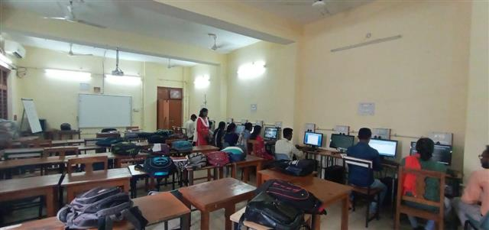
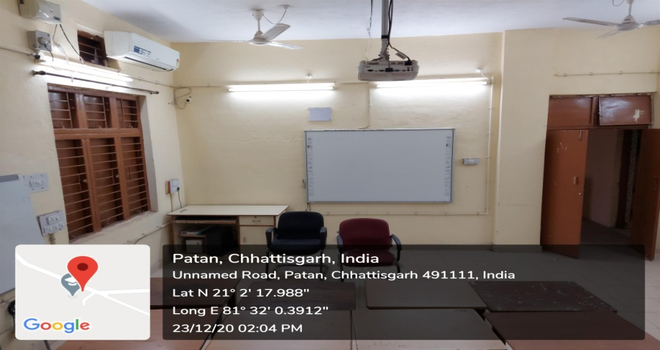
PGDCA
This department was established by the college from session 2013-14 to provide computer knowledge. Initially the number of post was 25. It is now 45 from session 2019-20. PGDCA is one year course, runs under semester system and affiliated to Hemchand Yadav University Durg.
The first In-charge HoD was Dr. R. K. Verma (Asstt. Prof. in Mathematics). Now, the present HoD is Mr. Ugendra Kurrey (Asstt. Prof. Physics).
This course is run by self-financing scheme. There are two posts sanctioned by the local Management committee (Janbhagidari Prabandhan Samiti).
At present we have well furnished, Air Conditioned computer lab having 25 computers well connected with LAN . Also we have Digital Board for students.

Slide 18
FIRST SEMESTER
PGDCA-101 : Introduction to software organization
PGDCA-102 : Programming in “C”
PGDCA-103 : Office Automation & Tally
Practical based in MS-Word , Excel, PowerPoint ,Tally and C Language.
SECOND SEMESTER
PGDCA-106 : GUI - Programming in Visual Basic.
PGDCA-107 : Database Management System
PGDCA-108 : Essential of E –Commerce & HTML .
Practical based in Visual Basic, SQL, HTML/WEB page Design and Project work

Slide 19
Result Analysis
YEAR | ENROLLED | APPEARED | PASS | RESULT
2014-15 | 28 | 28 | 28 | 100%
2015-16 | 35 | 35 | 34 | 97.14%
2016-17 | 35 | 32 | 31 | 96.87%
2017-18 | 35 | 35 | 34 | 97.14%
2018-19 | 35 | 33 | 33 | 100%
2019-20 | 35 | 35 | 34 | 97.14%

Slide 20
THANKS FOR YOUR KIND ATTENTION

